Slide 1

INVESTMENT ANALYTICS
DETAILED PROJECT REPORT
SANJEEV KUMAR
iNeuron

Slide 2





PROJECT DETAILS
Project Title | Investment Analytics
Technology | Business Intelligence
Domain | Finance
Project Difficulty level | Intermediate
Programming Language Used | Python
Tools Used | Jupyter Notebook, MS-Excel, Tableau
iNeuron

Slide 3
OBJECTIVE
▶ The goal of this project is to find the equilibrium investment from the given dataset.
iNeuron

Slide 4
PROBLEM STATEMENT
▶ Investment is a game of understanding historic data of investment objects under different events but it is still a game of chances to minimize the risk we apply analytics to find the equilibrium investment.
▶ A dataset is formed by 63 different sectors and 17 years data from 2000-01 to 2016-17.
iNeuron

Slide 5
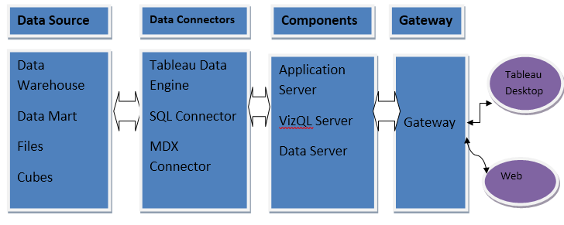

Slide 6
Sector: In the 1st column, Sector names are mentioned. There are total different 63 sectors, some of them are AGRICULTURAL MACHINERY, AGRICULTURE SERVICES, AUTOMOBILE INDUSTRY, COMPUTER SOFTWARE & HARDWARE etc.
Why These Parameters are Important?
Year wise – Except 1st column, There are different 17 columns and in the columns years are mentioned from 2000-01 to 2016-17. In these column, Investment are mentioned.

Slide 7

INSIGHTS
How many sectors are in given dataset?

Slide 8
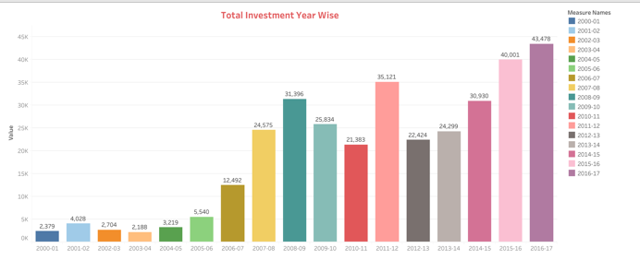
Total Investment at Year on Year basis
It is important part to analysis how much investment is done year by year.

Slide 9
Other Observations:
Maximum investment is done in SERVICES SECTOR in 2016-17 whereas minimum investment is done in COIR.
It is also observed in 2000-01, There are 23 sectors in which no investment is done which is also maximum of no investment in any year.
Out of 63 sectors, In 36 sectors average investment is under 100.

Slide 10
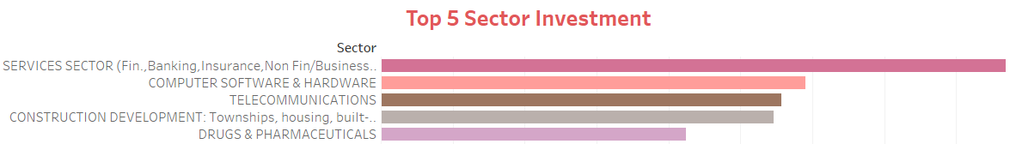
Top 5 Sectors, Maximum Individual Investment

Slide 11
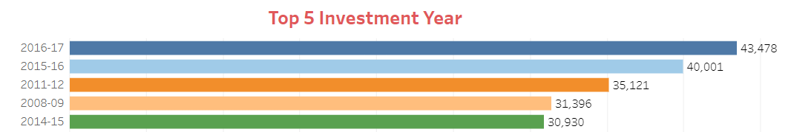
Top 5 Year in terms of Investment

Slide 12
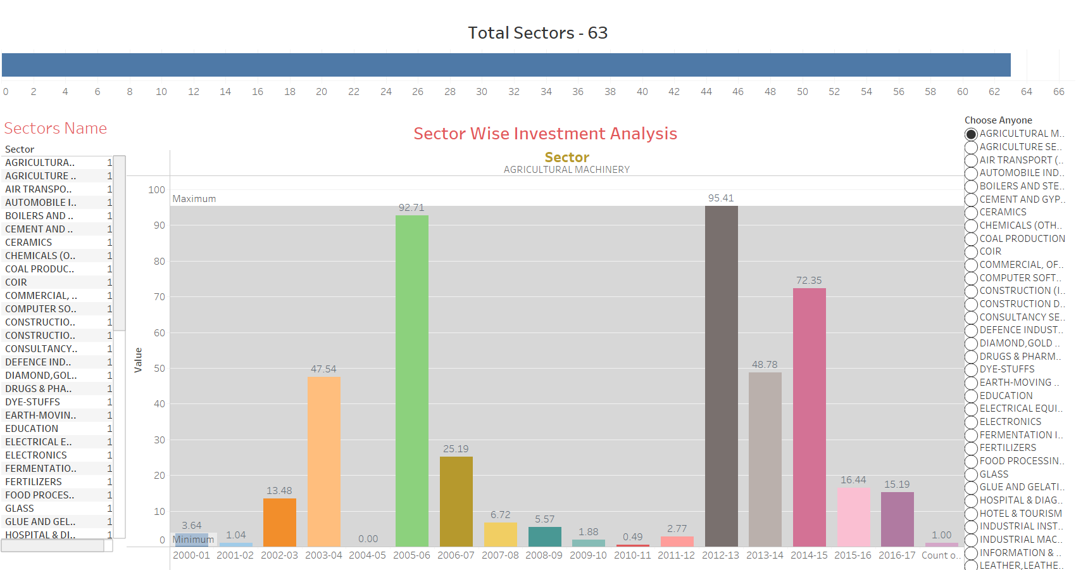

Slide 13
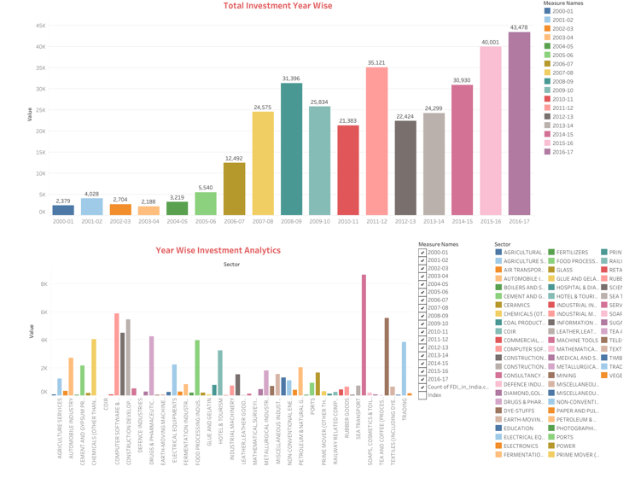

Slide 14
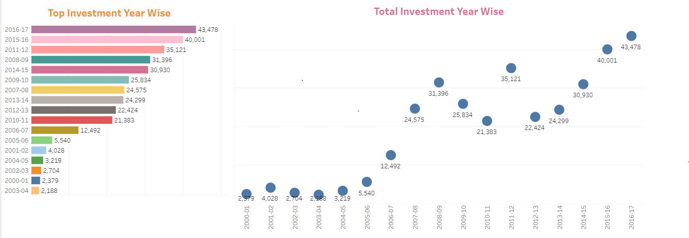
Year Wise Analytics

Slide 15
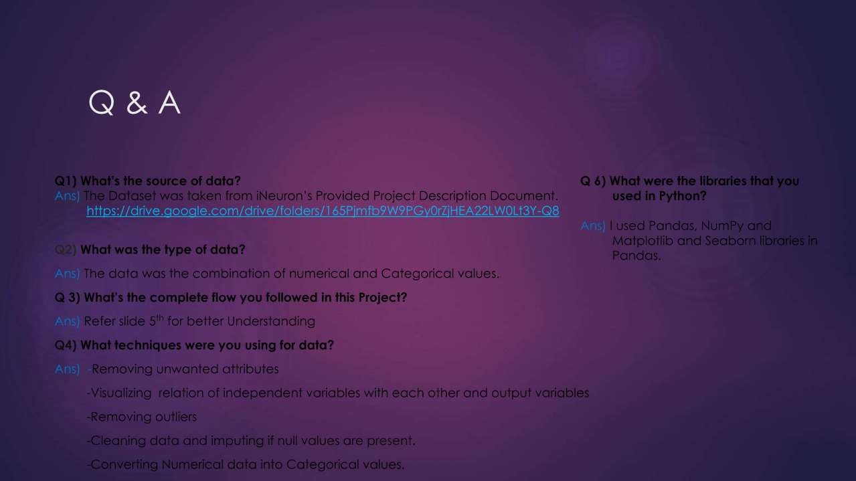

Slide 16
THANK YOU!

